Slide 1
Software Development 2
Socrative room: F27SB Quiz is already active
Abstract Classes
F27SB

Slide 2
Review (last lecture)
The declared type of a variable is its static type.
Compilers check static types.
The type of an object is its dynamic type.
Dynamic types are used at runtime.
Methods may be overridden in a subclass.
Method lookup starts with the dynamic type.
Protected access supports inheritance.

Slide 3
Further abstraction techniques to be covered
Abstract classes
Interfaces
Multiple inheritance

Slide 4
Today’s example
SIMULATORS

Slide 5
Simulations
Programs regularly used to simulate real-world activities.
city traffic
the weather
stock market fluctuations
environmental changes
etc.
Often implemented using Agent-Based Modelling (ABM).

Slide 6
Simulations
They are often only partial simulations.
They often involve simplifications.
Greater detail has the potential to provide greater accuracy.
Greater detail typically requires more resource
Processing power
Simulation time

Slide 7

Benefits of simulations
Support useful prediction.
The weather.
Allow experimentation.
Safer, cheaper, quicker.
Example:
‘How will the wildlife be affected if we cut a highway through the middle of this national park?’
A useful tool for research.

Slide 8

Predator-prey simulations
There is often a delicate balance between species.
A lot of prey means a lot of food.
A lot of food encourages higher predator numbers.
More predators eat more prey.
Less prey means less food.
Less food means ...
8

Slide 9

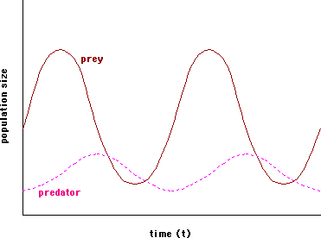
Idealised Predator-Prey Relationship

Slide 10
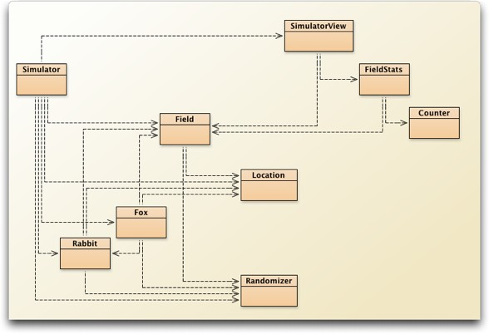
The foxes-and-rabbits project

Slide 11
Main classes of interest
Fox
Simple model of a type of predator.
Rabbit
Simple model of a type of prey.
Simulator
Manages the overall simulation task.
Holds a collection of foxes and rabbits.

Slide 12
The remaining classes
Field
Represents a 2D field.
Location
Represents a 2D position.
SimulatorView, FieldStats, Counter
Maintain statistics and present a view of the field.

Slide 13

A Rabbit’s state
public class Rabbit
{
//Static fields omitted.
//Individual characteristics (instance fields).
//The rabbit's age. private int age;
//Whether the rabbit is alive or not. private boolean alive;
//The rabbit's position private Location location;
//The field occupied private Field field;
//Methods omitted.
}

Slide 14
A Rabbit’s behaviour
Managed from the run method.
age incremented at each simulation ‘step’.
A rabbit could die at this point.
Rabbits that are old enough might breed at each step.
New rabbits could be born at this point.

Slide 15
Rabbit simplifications
Rabbits do not have different genders.
– In effect, all are female.
The same rabbit could breed at every step.
All rabbits die at the same age.
Others?

Slide 16

A Fox’s state
public class Fox
{
//Static fields omitted
//The fox's age. private int age;
//Whether the fox is alive or not. private boolean alive;
//The fox's position private Location location;
//The field occupied private Field field;
//The fox's food level, which is increased
//by eating rabbits. private int foodLevel;
//Methods omitted.
}

Slide 17
A Fox’s behaviour
Managed from the hunt method.
Foxes also age and breed.
They become hungry.
They hunt for food in adjacent locations.

Slide 18

static final Constants
static = variables that are common to all objects. -> “Class field”
final = the value of this field cannot changed. -> “Constant”
//The age to which a fox can live. private static final int MAX_AGE = 40;

Slide 19


static final Constants
Only use static and final if you know what you’re doing.
If Eclipse tells you to make something static, there is (almost) always something else wrong:
Most likely just forgotten to create an instance of your class

Slide 20
Interlude
ITERATORS

Slide 21
Iterators
Used to traverse collections
Curser running along the data entries
Three operations:
hasNext: Returns true/false depending on if there is a next element
next: Moves the curser forward and returns the new element
remove: removes the element

Slide 22
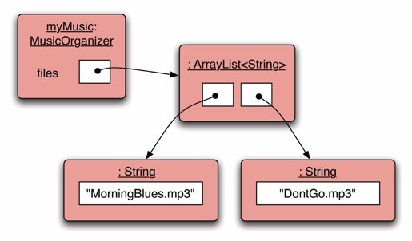


Iterators
Iterator
hasNext();
>> true
22

Slide 23

Iterators
Iterator
next();
>> MorningBlues.mp3
23

Slide 24
Iterators
Iterator
hasNext();
>> true
24

Slide 25

Iterators
Iterator
next();
>> DontGo.mp3
25

Slide 26
Iterators
Iterator
hasNext();
>> false
26

Slide 27
Let’s eat some rabbits
BACK TO THE EXAMPLE

Slide 28
The Simulator class
Three key components:
Setup in the constructor.
The populate method.
Generate class instances of foxes and rabbits.
Each animal is given a random starting age.
The simulateOneStep method.
Iterates over separate populations of foxes and rabbits.
Two Field objects are used: field and
updatedField.

Slide 29


The update step
for(Iterator<Rabbit> it = rabbits.iterator(); it.hasNext();) {
Rabbit rabbit = it.next(); rabbit.run(newRabbits); if(! rabbit.isAlive()) {
it.remove();
}
}
…
for(Iterator<Fox> it = foxes.iterator(); it.hasNext();) {
Fox fox = it.next(); fox.hunt(newFoxes); if(! fox.isAlive()) {
it.remove();
}
Code duplication
}

Slide 30
Room for improvement
Fox and Rabbit have strong similarities but do not have a common superclass.
The update step involves similar-looking code
The Simulator is tightly coupled to specific classes.
– It ‘knows’ a lot about the behaviour of foxes and rabbits.

Slide 31
Better coding practise
Phenomena like:
code duplication and
tight coupling
indicate that this code doesn’t follow OOP principles.
How can we use inheritance to improve the quality of the code?

Slide 32


The Animal superclass
Place common fields in Animal:
field, alive, location
Method renaming to support information hiding:
run and hunt become act.
Simulator can now be significantly decoupled.
age could be place in Animal as well.
Requires more changes than I have time for.

Slide 33

Revised (decoupled) iteration
for(Iterator<Animal> it =
animals.iterator();
(while it.hasNext()) {
Animal animal = iter.next(); animal.act(newAnimals);
//Remove dead animals from simulation if(! animal.isAlive()) {
it.remove();
}
}

Slide 34

The act method of Animal
There is no obvious shared implementation between Foxes and Rabbits.
Define act as abstract:
abstract public void
act(List<Animal> newAnimals);

Slide 35
Abstract methods
Abstract methods have abstract in the signature.
Abstract methods have no body (without braces, and followed by a semicolon).
abstract public void
act(List<Animal> newAnimals);
Abstract methods make the class abstract.

Slide 36
Abstract classes
Abstract classes cannot be instantiated, i.e. no instances of this type can be created.
Its purpose is to serve as a superclass for other classes.
Concrete subclasses complete the implementation.
A subclass must implement all abstract methods (otherwise it will be abstract itself.)
Abstract classes may contain abstract methods and also implemented methods (i.e. with a body).

Slide 37

The Animal class
public abstract class Animal
{
//fields omitted
/**
Make this animal act - that is: make it do
whatever it wants/needs to do.
*/
abstract public void act(List<Animal> newAnimals);
//other methods omitted
}

Slide 38
Summary
Version-1 of the FoxesAndRabbits simulation does not follow OOP principles.
Code refactoring in Version-2: Abstract methods and classes help to reduce code duplication and coupling.
OOP principles of inheritance and abstraction & modularisation.

Slide 39
Final remark
You will not be able to complete lab 4 within one lab slot.
You will have to work on this in your free time!

Slide 40
THAT’S IT!

Slide 41
Homework
Read Chapters 10.1- 10.4.
41

